Slide 1
Chapter 3
Data Warehousing and Analytical Processing

Slide 2
Outline
Data warehouse
Data warehouse modeling: schema and measures
OLAP operations
Data cube computation
Data cube computation methods

Slide 3
Outline
Data warehouse
  Data warehouse: what and why?
  Architecture of data warehouses: enterprise data warehouses and data marts
  Data lakes
Data warehouse modeling: schema and measures
OLAP operations
Data cube computation
Data cube computation methods

Slide 4

What is a Data Warehouse?
Defined in many different ways, but not rigorously
  A decision support database that is maintained separately from the organization’s operational database
  Support information processing by providing a solid platform of consolidated, historical data for analysis
“A data warehouse is a subject-oriented, integrated, time-variant, and nonvolatile collection of data in support of management’s decision-making process.”—W. H. Inmon
Data warehousing:
  The process of constructing and using data warehouses

Slide 5
Data Warehouse—Subject-Oriented
Organized around major subjects, such as customer, product, sales
Focusing on the modeling and analysis of data for decision makers, not on daily operations or transaction processing
Provide a simple and concise view around particular subject issues by excluding data that are not useful in the decision support process

Slide 6
Data Warehouse—Integrated
Constructed by integrating multiple, heterogeneous data sources
  relational databases, flat files, on-line transaction records
Data cleaning and data integration techniques are applied.
  Ensure consistency in naming conventions, encoding structures, attribute measures, etc. among different data sources
    Ex. Hotel price: differences on currency, tax, breakfast covered, and parking
  When data is moved to the warehouse, it is converted

Slide 7
Data Warehouse—Time Variant
The time horizon for the data warehouse is significantly longer than that of operational systems
  Operational database: current value data
  Data warehouse data: provide information from a historical perspective (e.g., past 5-10 years)
Every key structure in the data warehouse
  Contains an element of time, explicitly or implicitly
  But the key of operational data may or may not contain “time element”

Slide 8
Data Warehouse—Nonvolatile
Independence
  A physically separate store of data transformed from the operational environment
Static: Operational update of data does not occur in the data warehouse environment
  Does not require transaction processing, recovery, and concurrency control mechanisms
  Requires only two operations in data accessing:
    initial loading of data and access of data

Slide 9
OLTP vs. OLAP
OLTP: Online transactional processing
  DBMS operations
  Query and transactional processing
OLAP: Online analytical processing
  Data warehouse operations
  Drilling, slicing, dicing, etc.

Slide 10
Why a Separate Data Warehouse?
High performance for both systems
  DBMS— tuned for OLTP: access methods, indexing, concurrency control, recovery
  Warehouse—tuned for OLAP: complex OLAP queries, multidimensional view, consolidation
Different functions and different data:
  missing data: Decision support requires historical data which operational DBs do not typically maintain
  data consolidation: DS requires consolidation (aggregation, summarization) of data from heterogeneous sources
  data quality: different sources typically use inconsistent data representations, codes and formats which have to be reconciled
Note: There are more and more systems which perform OLAP analysis directly on relational databases

Slide 11
Data Warehouse: A Multi-Tiered Architecture
Top Tier: Front-End Tools
Middle Tier: OLAP Server
Bottom Tier: Data Warehouse Server
Data

Slide 12
Three Data Warehouse Models
Enterprise warehouse
  Collects all of the information about subjects spanning the entire organization
Data Mart
  A subset of corporate-wide data that is of value to a specific groups of users
  Its scope is confined to specific, selected groups, such as marketing data mart
    Independent vs. dependent (directly from warehouse) data mart
Virtual warehouse
  A set of views over operational databases
  Only some of the possible summary views may be materialized

Slide 13
Extraction, Transformation, and Loading (ETL)
Data extraction
  get data from multiple, heterogeneous, and external sources
Data cleaning
  detect errors in the data and rectify them when possible
Data transformation
  convert data from legacy or host format to warehouse format
Load
  sort, summarize, consolidate, compute views, check integrity, and build indices and partitions
Refresh
  propagate the updates from the data sources to the warehouse
Notes:
MK 08.11.09 Former title: Data Warehouse Back-End Tools and Utilities

Slide 14
Metadata Repository
Meta data is the data defining warehouse objects. It stores:
  Description of the structure of the data warehouse
    schema, view, dimensions, hierarchies, derived data, data mart locations and contents
  Operational meta-data
    data lineage (history of migrated data and transformation path), currency of data (active, archived, or purged), monitoring information (warehouse usage statistics, error reports, audit trails)
  The algorithms used for summarization
  The mapping from operational environment to the data warehouse
  Data related to system performance
    warehouse schema, view and derived data definitions
  Business data
    business terms and definitions, ownership of data, charging policies

Slide 15
Data Lake
A data lake is a centralized repository storing all structured and unstructured data at any scale in an organization
Data is stored as is, without having to first structure the data, and run different types of analytics—from dashboards and visualizations to big data processing, real-time analytics, and machine learning to guide better decision

Slide 16
Layers of Storage

Slide 17
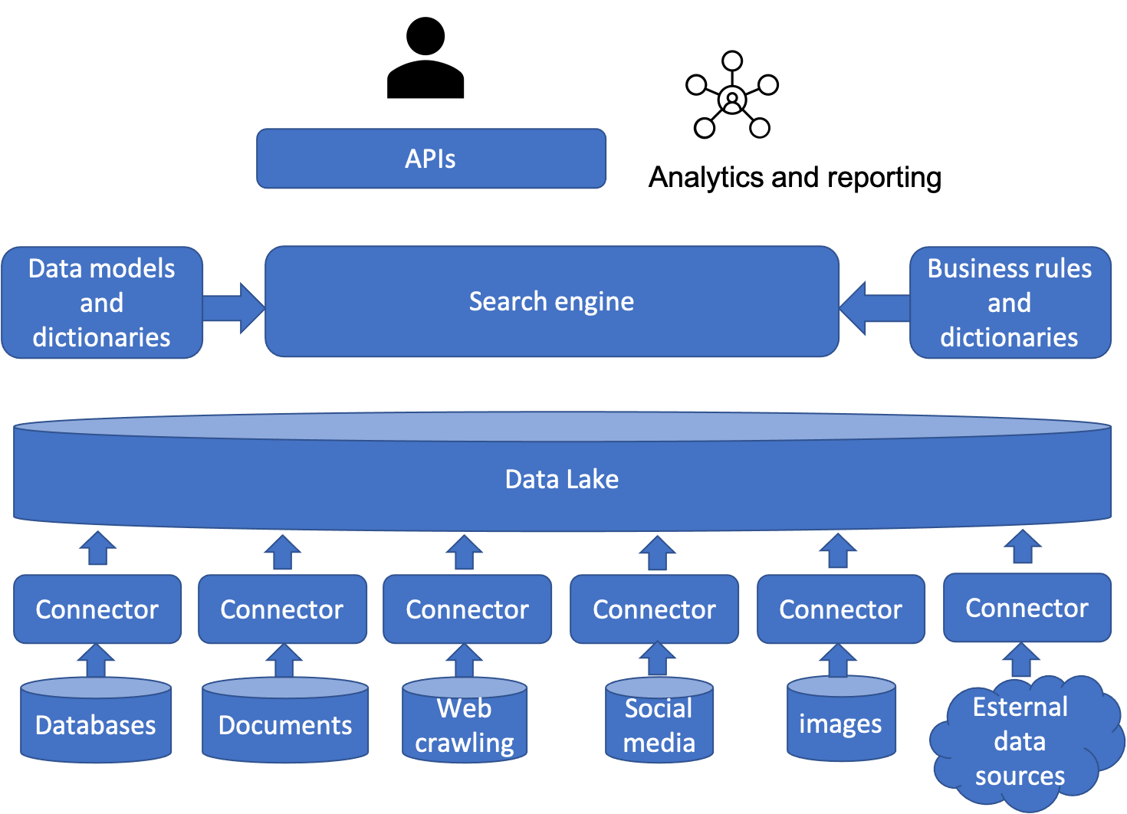
Conceptual Architecture

Slide 18
(Enterprise) Data Organization
Import
Unstructured data with schema
Analytics
Schema inference
Schema
Unstructured data
Extraction
Schema inference
Structured data
Parsing
Data lake

Slide 19
Data Lake Challenges
Many data sets, hundreds of thousands and more
Complicated queries: keyword queries, finding joinable data sets, finding features, …
Core task in building data lake: meta data management

Slide 20
Data Cleaning in Data Lakes
Data cleaning is the No. 1 most cited task in data lake
Over 85% considered it either major or critical to the business

Slide 21
Evolving Data in Data Lakes
Many duplicates as data sets are often being copied for new projects
Data sets are constantly being updated, having their schema altered, being derived into new ones, and disappearing/reappearing
Data set versioning is to maintain all versions of datasets for storage cost-saving, collaboration, auditing, and experimental reproducibility

Slide 22
Diversity in Data Lakes
Dataset formats in the open world can be highly heterogeneous
Ingestion and extraction is the task of bringing structured datasets into data lake
  Ingest already-structured data sets
  Extract structured data from unstructured and semi-structured data sources
Data Integration is the task of finding joinable or union-able tables or of on-demand population a schema with all data from the lake that conforms to the schema
  Example: enrich Electronic Health Records (EPR) using data from various non-standard personal health record data sets for better predicting health risks
  Joining or “union-ing” tables from different data sets and sources

Slide 23
Common Tasks in Building Data Lakes
Ingestion
Extraction (Type Inference)
Metadata Management
Cleaning
Integration
Discovery
Versioning

Slide 24
Metadata Management in Data Lakes: Ideas
Enrich data and meta data with semantic information, support template-based queries on metadata
Extract deeply embedded metadata and contextual metadata to support topic-based discovery
Integrate metadata about data, users, and queries, and support visual analytics

Slide 25
Two Purposes and Ecosystems
Analytic use cases: decision support based on data
  Data warehouses
  Structured data, SQL/Python
Operational use cases: data intelligence in applications
  Data lakes
  Raw data, Java/Scala, Python, R, and SQL
Potential convergence of data warehouses and data lakes

Slide 26
Data Lakehouses
“A data lakehouse is a new, open data management architecture that combines the flexibility, cost-efficiency, and scale of data lakes with the data management and ACID transactions of data warehouses, enabling business intelligence (BI) and machine learning (ML) on all data.” (Databricks)

Slide 27
Lakehouses
Transaction support
Schema enforcement and governance
BI support
Decoupling between storage and compute
Open storage formats
Support for diverse data types, ranging from unstructured to structured
Support for diverse workloads: data science, machine learning, SQL and analytics
End-to-end streaming: real-time reports

Slide 28
Data Fabric and Data Virtualization
“Data fabric is an architecture that facilitates the end-to-end integration of various data pipelines and cloud environments through the use of intelligent and automated systems” (IBM)
A holistic and unified data architecture that enables organizations to manage data across their entire ecosystem, regardless of the source, format, location, or technology
A data fabric provides a single point of access to all data, while abstracting away the underlying complexity and heterogeneity of the data landscape

Slide 29
Data Mesh
A data mesh creates multiple domain-specific systems, each specialized according to its functions and uses, thus bringing data closer to consumers
Data Mesh is a specific architecture pattern focused on data management

Slide 30
Data Virtualization
“Data virtualization is one of the technologies that enables a data fabric approach. Rather than physically moving the data from various on-premises and cloud sources using the standard ETL (extract, transform, load) processes, a data virtualization tool connects to the different sources, integrating only the metadata required and creating a virtual data layer”
Data Virtualization can be a component or a layer in a data fabric architecture

Slide 31
HTAP（Hybrid Transactional/Analytical Processing）是一种混合事务/分析处理技术，它允许在一个数据库系统中同时进行高吞吐量的事务处理（OLTP）和复杂的实时数据分析（OLAP）。
Why HTAP？
传统独立运行架构：一个用于处理日常交易，如订单处理、库存管理（OLTP）；另一个用于进行数据分析，如业务报表、市场趋势分析（OLAP）。
挑战：
数据延迟：需要将数据从OLTP数据库抽取、转换后加载到OLAP数据库中，这个过程通常是周期性的，导致分析结果总是滞后的。
高昂成本：需要购买、维护两套独立的系统和基础设施。
运维复杂：管理两套不同的数据库系统，涉及数据同步、ETL（提取、转换、加载）等复杂流程。

Slide 32
HTAP的优势
实时决策：企业可以基于最新的业务数据进行实时分析和决策，比如零售商可以实时分析顾客行为，并立刻调整推荐策略。
简化架构：消除了对独立数据仓库和ETL工具的需求，大大简化了数据架构，降低了运维复杂度。
降低成本：减少了硬件、软件和人力成本，提高了资源利用率。

Slide 33
典型应用场景
金融风控：实时监控交易行为，进行欺诈分析和风险评估。
电商推荐：实时分析用户浏览和购买行为，提供个性化的商品推荐。
智能制造：实时收集生产线数据，进行质量控制和故障预测

Slide 34
Outline
Data warehouse
Data warehouse modeling: schema and measures
  Data cube: a multidimensional data model
  Schemas for multidimensional data models: stars, snowflakes, and fact constellations
  Concept hierarchies
  Measures: categorization and computation
OLAP operations
Data cube computation
Data cube computation methods

Slide 35
From Tables and Spreadsheets to Data Cubes
A data warehouse is based on a multidimensional data model which views data in the form of a data cube
A data cube, such as sales, allows data to be modeled and viewed in multiple dimensions
  Dimension tables, such as item (item_name, brand, type), or time(day, week, month, quarter, year)
  Fact table contains measures (such as dollars_sold) and keys to each of the related dimension tables
Data cube: A lattice of cuboids
  In data warehousing literature, an n-D base cube is called a base cuboid
  The top most 0-D cuboid, which holds the highest-level of summarization, is called the apex cuboid
  The lattice of cuboids forms a data cube.

Slide 36
Data Cube: A Lattice of Cuboids
all
0-D (apex) cuboid
time
item
location
supplier
1-D cuboids
time,location
item,location
location,supplier
time,item
2-D cuboids
time,supplier
item,supplier
time,location,supplier
3-D cuboids
time,item,location
time,item,supplier
item,location,supplier
4-D (base) cuboid
time, item, location, supplier

Slide 37
Conceptual Modeling of Data Warehouses
Modeling data warehouses: dimensions & measures
Star schema: A fact table in the middle connected to a set of dimension tables
Snowflake schema: A refinement of star schema where some dimensional hierarchy is normalized into a set of smaller dimension tables, forming a shape similar to snowflake
Fact constellations: Multiple fact tables share dimension tables, viewed as a collection of stars, therefore called galaxy schema or fact constellation

Slide 38
Star Schema: An Example
time
time_key
day
day_of_the_week
month
quarter
year
item
item_key
item_name
brand
type
supplier_type
Sales Fact Table
time_key
item_key
branch_key
branch
location
location_key
branch_key
branch_name
branch_type
location_key
street
city
state_or_province
country
units_sold
dollars_sold
avg_sales
Measures

Slide 39
Snowflake Schema: An Example
time
item
time_key
day
day_of_the_week
month
quarter
year
item_key
item_name
brand
type
supplier_key
supplier
Sales Fact Table
supplier_key
supplier_type
time_key
item_key
branch_key
branch
location
location_key
location_key
street
city_key
branch_key
branch_name
branch_type
units_sold
dollars_sold
city
city_key
city
state_or_province
country
avg_sales
Measures

Slide 40
Fact Constellation: An Example
time
time_key
day
day_of_the_week
month
quarter
year
item
Shipping Fact Table
item_key
item_name
brand
type
supplier_type
Sales Fact Table
time_key
time_key
item_key
shipper_key
item_key
branch_key
from_location
branch
location_key
location
to_location
branch_key
branch_name
branch_type
units_sold
location_key
street
city
province_or_state
country
dollars_cost
dollars_sold
units_shipped
avg_sales
shipper
Measures
shipper_key
shipper_name
location_key
shipper_type

Slide 41
A Concept Hierarchy for a Dimension (location)
all
all
region
Europe
...
North_America
country
Germany
...
Spain
Canada
...
Mexico
city
Frankfurt
...
Vancouver
...
Toronto
office
L. Chan
...
M. Wind

Slide 42
Data Cube Measures: Three Categories
Distributive: if the result derived by applying the function to n aggregate values is the same as that derived by applying the function on all the data without partitioning
    E.g., count(), sum(), min(), max()
Algebraic: if it can be computed by an algebraic function with M arguments (where M is a bounded integer), each of which is obtained by applying a distributive aggregate function
    avg(x) = sum(x) / count(x)
    Is min_N() an algebraic measure? How about standard_deviation()?
Holistic: if there is no constant bound on the storage size needed to describe a subaggregate.
    E.g., median(), mode(), rank()

Slide 43
Multidimensional Data
Sales volume as a function of product, month, and region
Dimensions: Product, Location, Time
Hierarchical summarization paths
Region
Industry Region Year
Category Country Quarter
Product City Month Week
Office Day
Product
Month

Slide 44
A Sample Data Cube
Date
Total annual sales
of TVs in U.S.A.
1Qtr
2Qtr
3Qtr
4Qtr
sum
Product
TV
PC
U.S.A
VCR
sum
Canada
Country
Mexico
sum
All, All, All

Slide 45
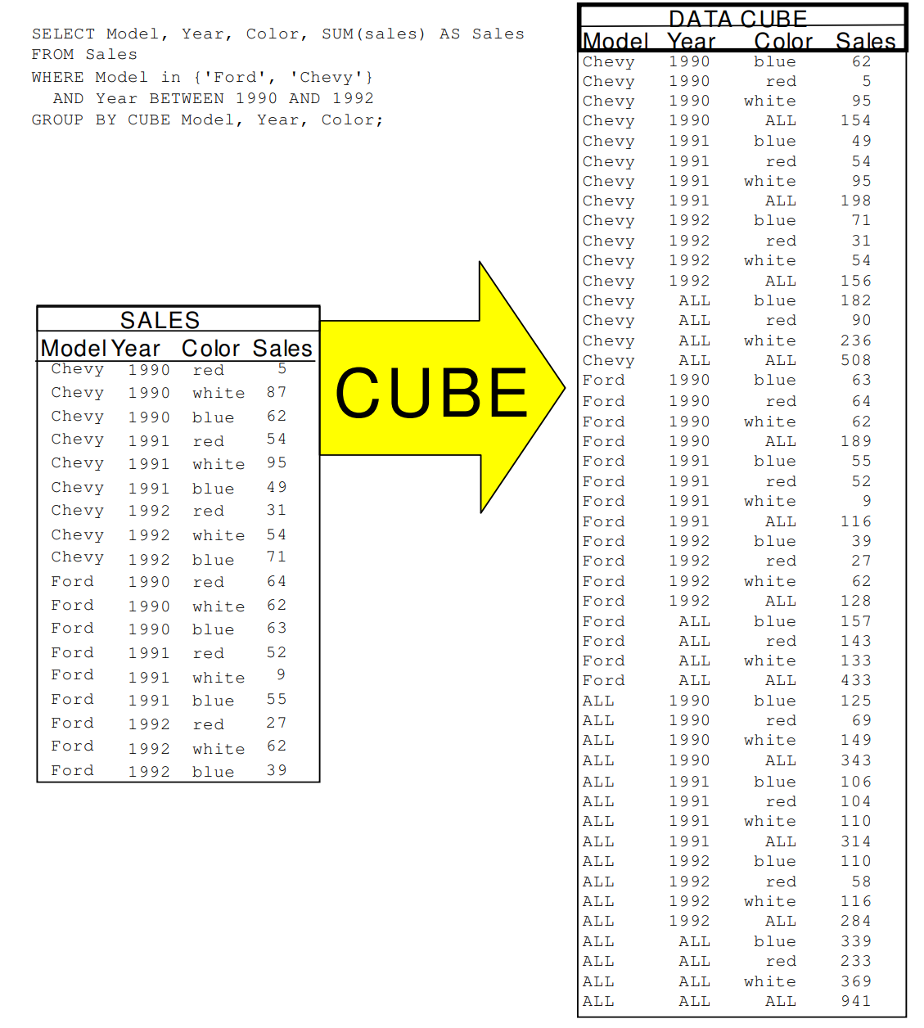


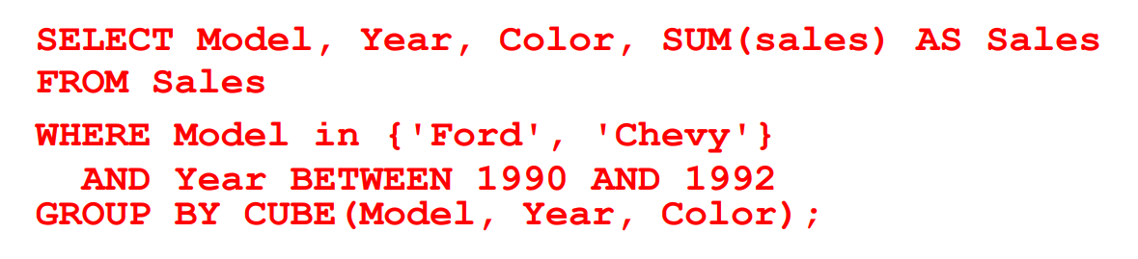
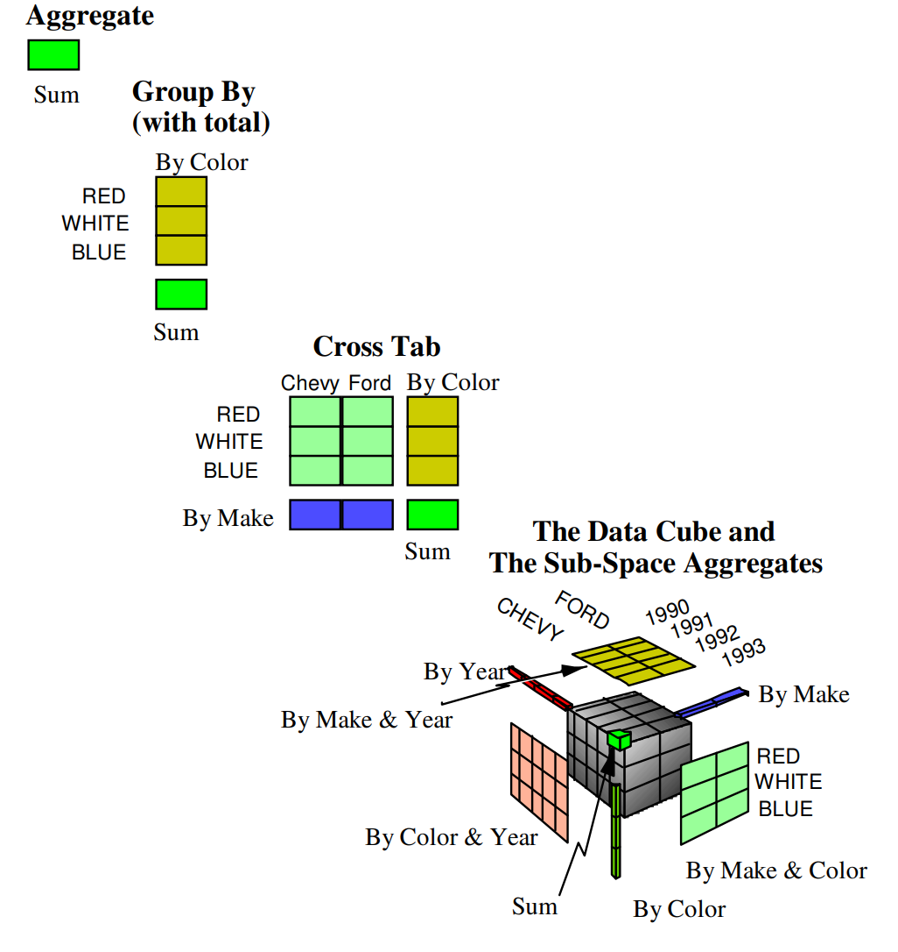
Cube
Jim Gray
(1944 – declared dead in absentia 2012)
Turing Award in 1998 "for seminal contributions to database and transaction processing research and technical leadership in system implementation"
Jim Gray, Surajit Chaudhuri, Adam Bosworth, Andrew Layman, Don Reichart, Murali Venkatrao, Frank Pellow, Hamid Pirahesh:
Data Cube: A Relational Aggregation Operator Generalizing Group-by, Cross-Tab, and Sub Totals. Data Min. Knowl. Discov. 1(1): 29-53 (1997)

Slide 46
Cuboids Corresponding to the Cube
all
0-D (apex) cuboid
product
date
country
1-D cuboids
product,date
product,country
date, country
2-D cuboids
3-D (base) cuboid
product, date, country

Slide 47
Outline
Data warehouse
Data warehouse modeling: schema and measures
OLAP operations
  Typical OLAP operations
  Indexing OLAP data: bitmap index and join index
  Storage implementation: column-based databases
Data cube computation
Data cube computation methods

Slide 48
Online Analytic Processing (OLAP)
Conceptually, we may explore all possible subspaces for interesting patterns
Some fundamental problems in analytics and data mining
  What patterns are interesting?
  How can we explore all possible subspaces systematically and efficiently?
Aggregates and group-bys are frequently used in data analysis and summarization
  SELECT time, altitude, AVG(temp)
  FROM weather GOUP BY time, altitude;
  In TPC, 6 standard benchmarks have 83 queries, aggregates are used 59 times, group-bys are used 20 times
Online analytical processing (OLAP): the techniques that answer multi-dimensional analytical (MDA) queries efficiently

Slide 49
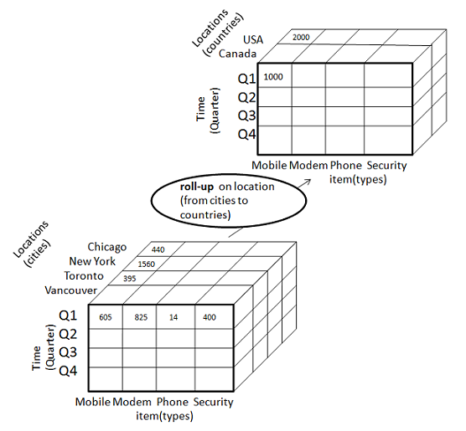
OLAP Operations
Roll up (drill-up): summarize data by climbing up hierarchy or by dimension reduction
  (Day, Store, Product type, SUM(sales) → (Month, City, *, SUM(sales))
Drill down (roll down): reverse of roll-up, from higher level summary to lower level summary or detailed data, or introducing new dimensions
http://www.tutorialspoint.com/dwh/images/rollup.jpg

Slide 50
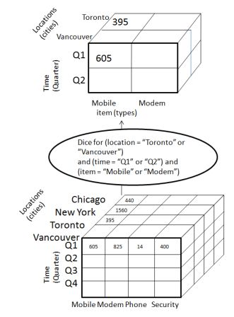
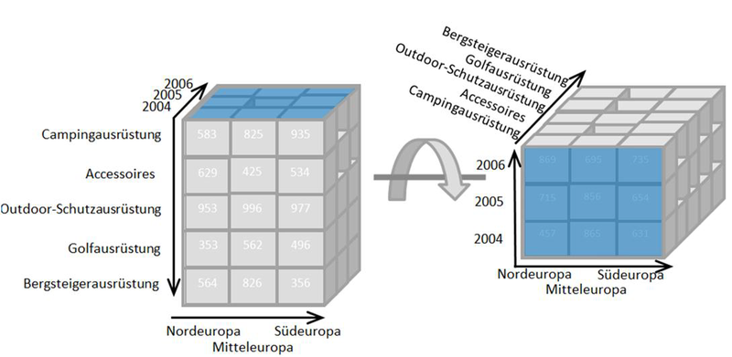
Other Operations
Dice: pick specific values or ranges on some dimensions
Pivot: “rotate” a cube – changing the order of dimensions in visual analysis
http://en.wikipedia.org/wiki/File:OLAP_pivoting.png
http://www.tutorialspoint.com/dwh/images/dice.jpg

Slide 51
Typical OLAP Operations

Slide 52
OLAP Query Example
In a table about medicine trials (age, gender, …, succeed, …), find the total number of succeeding trials
Method 1: scan the table once
Method 2: build a B+ tree index on attribute succeed, still need to access all records of succeeding trails
Can we get the count without scanning many records, even not all records of succeeding trails?

Slide 53
Bitmap Index
For n records, a bitmap index has n bits and can be packed into ⎡n /8⎤ bytes and ⎡n /32⎤ words
From a bit to the row-id: the j-th bit of the p-th byte → row-id = p*8 +j
Counting using bitmap index
  Shcount[] contains the number of bits in the entry subscript
  Example: shcount[01100101]=4
  count = 0;
  for (i = 0; i < SHNUM; i++)
  count += shcount[B[i]];
age | succeed | …
45 | 1 | …
37 | 0 | …
… | … | …
52 | 1 | …
1 | 0 | … | 0

Slide 54
Indexing OLAP Data Using Bitmap Indices

Slide 55
Bitmap Indices example
Base table
Index on Region
Index on Type
Query：
  Select cust From BaseTable
  Where Region=‘Asia’ and Type=‘Dealer’；
  BitMap for Region(Asia): 10100
  BitMap for Type(Dealer): 01101
  Result： 00100

Slide 56
Advantages of Bitmap Index
Efficient in space
Ready for logic composition
  C = C1 AND C2
  Bitmap operations can be used
Bitmap index only works for categorical data with low cardinality
  Naively, we need 50 bits per entry to represent the state of a customer in US
  How to represent a sale in dollars?

Slide 57
Bit-Sliced Index
A sale amount can be written as an integer number of pennies, and then be represented as a binary number of N bits
  32 bits is good for up to $42,949,672.95, appropriate for many stores
A bit-sliced index is N bitmaps
  Tuple j sets in bitmap k if the k-th bit in its binary representation is on
  The space costs of bit-sliced index is the same as storing the data directly
  SELECT SUM(sales) FROM Sales WHERE C;
  Tuples satisfying C is identified by a bitmap B
Direct access to rows to calculate SUM: scan the whole table once
B+ tree: find the tuples from the tree
Projection index: only scan attribute sales
Bit-sliced index: get the sum from ∑(B AND Bk)*2k
1 | 0 | 1 | 1
1 | 1 | 1 | 0
1 | 1 | 1 | 0
 |  | 3
2³ | 2² | 2¹ | 2⁰

Slide 58
Indexing OLAP Data Using Bit-sliced Indices

Slide 59
Indexing OLAP Data: Join Indices
Join index: JI(R-id, S-id) where R (R-id, …)  S (S-id, …)
Traditional indices map the values to a list of record ids
  It materializes relational join in JI file and speeds up relational join
In data warehouses, join index relates the values of the dimensions of a star schema to rows in the fact table.
  E.g., fact table: Sales and two dimensions city and product
    A join index on city maintains for each distinct city a list of R-IDs of the tuples recording the Sales in the city
  Join indices can span multiple dimensions

Slide 60
Join Index Example

Slide 61
Horizontal versus Vertical Storage
A fact table for data warehousing is often fat
  Tens of even hundreds of dimensions/attributes
A query is often about only a few attributes
Horizontal storage: tuples are stored one by one
Vertical storage: tuples are stored by attributes
A₁ | A₂ | … | A₁₀₀
x₁ | x₂ | … | x₁₀₀
… | … | … | …
z₁ | z₂ | … | z₁₀₀
A₁ | A₂ | … | A₁₀₀
x₁ | x₂ | … | x₁₀₀
… | … | … | …
z₁ | z₂ | … | z₁₀₀

Slide 62
Column-based Storage

Slide 63
Query Answering Using Vertical Storage
Find the information of tuple t
  Typical in OLTP
  Horizontal storage: get the whole tuple in one search
  Vertical storage: search 100 lists
Find SUM(a₁₀₀) GROUP BY {a₂₂, a₈₃}
  Typical in OLAP
  Horizontal storage (no index): search all tuples O(100n), where n is the number of tuples
  Vertical storage: search 3 lists O(3n), 3% of the horizontal storage method
Projection index: vertical storage in C-store

Slide 64
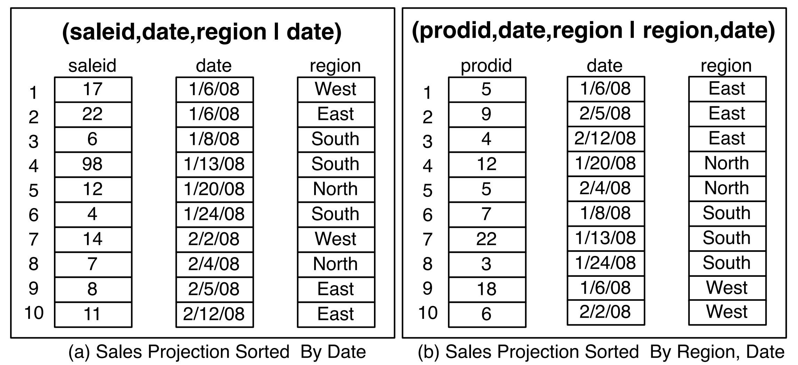
Different Projections in C-store

Slide 65
Outline
Data warehouse
Data warehouse modeling: schema and measures
OLAP operations
Data cube computation
  Terminology of data cube computation
  Data cube materialization: ideas
  OLAP server architectures: ROLAP vs. MOLAP vs. HOLAP
  General strategies for data cube computation
Data cube computation methods

Slide 66
Data Cube: A Lattice of Cuboids
all
0-D(apex) cuboid
time
item
location
supplier
1-D cuboids
time,location
item,location
location,supplier
2-D cuboids
time,item
time,supplier
item,supplier
time,location,supplier
3-D cuboids
time,item,location
time,item,supplier
item,location,supplier
4-D(base) cuboid
time, item, location, supplierc

Slide 67
Data Cube: A Lattice of Cuboids
all
0-D(apex) cuboid
time
item
location
supplier
Base vs. aggregate cells
Ancestor vs. descendant cells
Parent vs. child cells
(*,*,*)
(*, milk, *, *)
(*, milk, Urbana, *)
(*, milk, Chicago, *)
(9/15, milk, Urbana, *)
(9/15, milk, Urbana, Dairy_land)
1-D cuboids
time,item
time,location
item,location
location,supplier
item,supplier
2-D cuboids
time,supplier
time,location,supplier
3-D cuboids
time,item,location
time,item,supplier
item,location,supplier
time, item, location, supplier
4-D(base) cuboid

Slide 68
OLAP Server Architectures
Relational OLAP (ROLAP)
  Use relational or extended-relational DBMS to store and manage warehouse data and OLAP middle ware
  Include optimization of DBMS backend, implementation of aggregation navigation logic, and additional tools and services
  Greater scalability
Multidimensional OLAP (MOLAP)
  Sparse array-based multidimensional storage engine
  Fast indexing to pre-computed summarized data
Hybrid OLAP (HOLAP) (e.g., Microsoft SQLServer)
  Flexibility, e.g., low level: relational, high-level: array
Specialized SQL servers (e.g., Redbricks)
  Specialized support for SQL queries over star/snowflake schemas

Slide 69

Cube Materialization: Full Cube vs. Iceberg Cube
Full cube vs. iceberg cube
      compute cube sales iceberg as
      select month, city, customer group, count(*)
      from salesInfo
      cube by month, city, customer group
      having count(*) >= min support
Compute only the cells whose measure satisfies the iceberg condition
Only a small portion of cells may be “above the water’’ in a sparse cube
Ex.: Show only those cells whose count is no less than 100
iceberg condition
Notes:
69
2*(2^{100}-1)-1, 1
Explanation: one cell, such as (a1, a2, …., a100) generates 2^100 -1 aggregate cells, because choose(100 1) + choose (100 2) + ... choose (100, 100) = 2^100 - 1 aggregate cells.
For two cell question, it generates 2 * (2^100-1) -1 distinct aggregate cells because (*, *, …, *) generated by (a1, a2, …., a100) and (b1, b2, …, b100) will be merged into one cell:
(*, *, …, *): 2. Hence we have 2*(2^{100}-1)-1

Slide 70
Why Iceberg Cube?
Advantages of computing iceberg cubes
  No need to save nor show those cells whose value is below the threshold (iceberg condition)
  Efficient methods may even avoid computing the un-needed, intermediate cells
  Avoid explosive growth
Example: a cube with 100 dimensions
  Suppose it contains only 2 base cells: {(a₁, a₂, a₃, …., a₁₀₀), (a₁, a₂, b₃, …, b₁₀₀)}
  How many aggregate cells if “having count >= 1”? Answer: (2¹⁰¹ ─ 2) ─ 4 (Why?!)
  What about the iceberg cells, (i,e., with condition: “having count >= 2”)? Answer: 4 (Why?!)
Notes:
For {(a₁, a₂, a₃ . . . , a₁₀₀), (a₁, a₂, b₃, . . . , b₁₀₀)}, the total # of non-base cells should be 2 * (2^{100} – 1) – 4.
This is calculated as follows:
(a1, a2, a3 . . . , a100) will generate 2^{100} - 1 non-base cells
(a1, a2, b3, . . . , b100) will generate 2^{100} - 1 non-base cells
Among these, 4 cells are overlapped and thus minus 4 so we get: 2*2^{100} - 2 - 4 = 2*2^{100} - 6
These 4 cells are:
(a1, a2, *, ..., *): 2
(a1, *, *, ..., *): 2
(*, a2, *, ..., *): 2
(*, *, *, ..., *): 2

Slide 71
Is Iceberg Cube Good Enough? Closed Cube & Cube Shell
Let cube P have only 2 base cells: {(a1, a2, a3 . . . , a100):10, (a1, a2, b3, . . . , b100):10}
  How many cells will the iceberg cube contain if “having count(*) ≥ 10”? Answer: 2¹⁰¹ ─ 4 (still too big!)
Close cube:
  A cell c is closed if there exists no cell d, such that d is a descendant of c, and d has the same measure value as c
  Ex. The same cube P has only 3 closed cells: {(a1, a2, *, …, *): 20, (a1, a2, a3 . . . , a100): 10, (a1, a2, b3, . . . , b100): 10}
  A closed cube is a cube consisting of only closed cells
Cube Shell: The cuboids involving only a small # of dimensions, e.g., 2
  Idea: Only compute cube shells, other dimension combinations can be computed on the fly
Q: For (A₁, A₂, … A₁₀₀), how many combinations to compute?

Slide 72
Roadmap for Efficient Computation
General computation heuristics (Agarwal et al.’96)
Computing full/iceberg cubes: 3 methodologies
  Bottom-Up: Multi-Way array aggregation (Zhao, Deshpande & Naughton, SIGMOD’97)
  Top-down: BUC (Beyer & Ramarkrishnan, SIGMOD’99)
  Integrating Top-Down and Bottom-Up: Star-cubing algorithm (Xin, Han, Li & Wah: VLDB’03)
High-dimensional OLAP:
  A Shell-Fragment Approach (Li, et al. VLDB’04)
Computing alternative kinds of cubes:
  Partial cube, closed cube, approximate cube, ……

Slide 73
Efficient Data Cube Computation: General Heuristics
Aggregates may be computed from previously computed aggregates, rather than from the base fact table
Smallest-child: computing a cuboid from the smallest, previously computed cuboid
Cache-results: caching results of a cuboid from which other cuboids are computed to reduce disk I/Os
Amortize-scans: computing as many as possible cuboids at the same time to amortize disk reads
Share-sorts: sharing sorting costs cross multiple cuboids when sort-based method is used
Share-partitions: sharing the partitioning cost across multiple cuboids when hash-based algorithms are used
Sorting, hashing, and grouping operations are applied to the dimension attributes in order to reorder and cluster related tuples

Slide 74
Example: General Heuristics
all
product
date
country
prod,date
prod,country
date, country
prod, date, country
S. Agarwal, R. Agrawal, P. M. Deshpande, A. Gupta, J. F. Naughton, R. Ramakrishnan, S. Sarawagi. On the computation of multidimensional aggregates. VLDB’96

Slide 75
Outline
Data warehouse
Data warehouse modeling: schema and measures
OLAP operations
Data cube computation
Data cube computation methods
  Multiway array aggregation for full cube computation
  BUC: computing iceberg cubes from the apex cuboid downward
  Precomputing shell fragments for fast high-dimensional OLAP
  Efficient processing of OLAP queries using cuboids

Slide 76
Multi-Way Array Aggregation
Array-based “bottom-up” algorithm (from ABC to AB,…)
Using multi-dimensional chunks
Simultaneous aggregation on multiple dimensions
Intermediate aggregate values are re-used for computing ancestor cuboids
Cannot do Apriori pruning: No iceberg optimization
Pros and cons
  Efficient for computing the full cube for a small number of dimensions
  If there are a large number of dimensions, “top-down” computation and iceberg cube computation methods (e.g., BUC) should be used

Slide 77
Cube Computation: Multi-Way Array Aggregation (MOLAP)
Partition arrays into chunks (a small subcube which fits in memory).
Compressed sparse array addressing: (chunk_id, offset)
Compute aggregates in “multiway” by visiting cube cells in the order which minimizes the # of times to visit each cell, and reduces memory access and storage cost
C
c3
61
62
63
64
c2
45
46
47
48
c 0
c1
29
30
31
32
B
60
b3
13
14
15
16
44
What is the best traversing order to do multi-way aggregation?
b2
9
28
56
B
24
40
b1
5
36
52
1
2
3
4
20
b0
a0
a1
a2
a3
A

Slide 78
Multi-way Array Aggregation (3-D to 2-D)
How to minimizes the memory requirement and reduced I/Os?
Entire AB plane
4x4x4 chunks
A: 40, B: 400, C: 4000
Keep the smallest plane in main memory, fetch and compute only one chunk at a time for the largest plane
The planes should be sorted and computed according to their size in ascending order
One chunk of BC plane
One column of AC plane

Slide 79
Multi-Way Array Aggregation (2-D to 1-D)
Same methodology for computing 2-D and 1-D planes

Slide 80
Cube Computation: Computing in Reverse Order
BUC (Beyer & Ramakrishnan, SIGMOD’99)
    BUC: acronym of Bottom-Up (cube) Computation
    (Note: It is “top-down” in our view since we put Apex cuboid on the top!)
Divides dimensions into partitions and facilitates iceberg pruning
  If a partition does not satisfy min_sup, its descendants can be pruned
  If minsup = 1 Þ compute full CUBE!
No simultaneous aggregation

Slide 81
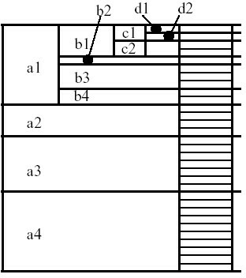
BUC: Partitioning and Aggregating
Usually, entire data set cannot fit in main memory
Sort distinct values
  partition into blocks that fit
Continue processing
Optimizations
  Partitioning
    External Sorting, Hashing, Counting Sort
  Ordering dimensions to encourage pruning
    Cardinality, Skew, Correlation
  Collapsing duplicates
    Cannot do holistic aggregates anymore!

Slide 82
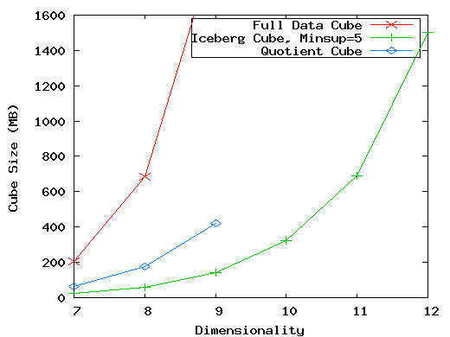
High-Dimensional OLAP?—The Curse of Dimensionality
High-D OLAP: Needed in many applications
  Science and engineering analysis
  Bio-data analysis: thousands of genes
  Statistical surveys: hundreds of variables
  A curse of dimensionality: A database of 600k tuples. Each dimension has cardinality of 100 and zipf of 2
None of the previous cubing method can handle high dimensionality!
  Iceberg cube and compressed cubes: only delay the inevitable explosion
  Full materialization: still significant overhead in accessing results on disk
A shell-fragment approach: X. Li, J. Han, and H. Gonzalez, High-Dimensional OLAP: A Minimal Cubing Approach, VLDB'04

Slide 83
Fast High-D OLAP with Minimal Cubing
Observation: OLAP occurs only on a small subset of dimensions at a time
Semi-Online Computational Model
  Partition the set of dimensions into shell fragments
  Compute data cubes for each shell fragment while retaining inverted indices or value-list indices
  Given the pre-computed fragment cubes, dynamically compute cube cells of the high-dimensional data cube online
Major idea: Tradeoff between the amount of pre-computation and the speed of online computation
  Reducing computing high-dimensional cube into precomputing a set of lower dimensional cubes
  Online re-construction of original high-dimensional space
  Lossless reduction

Slide 84
Computing a 5-D Cube with 2-Shell Fragments
Attribute Value | TID List | List Size
a1 | 1 2 3 | 3
a2 | 4 5 | 2
b1 | 1 4 5 | 3
b2 | 2 3 | 2
c1 | 1 2 3 4 5 | 5
d1 | 1 3 4 5 | 4
d2 | 2 | 1
e1 | 1 2 | 2
e2 | 3 4 | 2
e3 | 5 | 1
Example: Let the cube aggregation function be count
Divide the 5-D table into 2 shell fragments:
  (A, B, C) and (D, E)
Build traditional invert index or RID list
tid | A | B | C | D | E
1 | a1 | b1 | c1 | d1 | e1
2 | a1 | b2 | c1 | d2 | e1
3 | a1 | b2 | c1 | d1 | e2
4 | a2 | b1 | c1 | d1 | e2
5 | a2 | b1 | c1 | d1 | e3

Slide 85
Shell Fragment Cubes: Ideas
Generalize the 1-D inverted indices to multi-dimensional ones in the data cube sense
Compute all cuboids for data cubes ABC and DE while retaining the inverted indices
  Ex. shell fragment cube ABC contains 7 cuboids:
      A, B, C; AB, AC, BC; ABC
This completes the offline computation

Slide 86
Shell Fragment Cubes: Example of Ideas
ID_Measure Table
  If measures other than count are present, store in ID_measure table separate from the shell fragments
Attribute Value | TID List | List Size
a1 | 1 2 3 | 3
a2 | 4 5 | 2
b1 | 1 4 5 | 3
b2 | 2 3 | 2
c1 | 1 2 3 4 5 | 5
d1 | 1 3 4 5 | 4
d2 | 2 | 1
e1 | 1 2 | 2
e2 | 3 4 | 2
e3 | 5 | 1
Shell-fragment AB
tid | count | sum
1 | 5 | 70
2 | 3 | 10
3 | 8 | 20
4 | 5 | 40
5 | 2 | 30
Cell | Intersection | TID List | List Size
a1 b1 | 1 2 3 ∩ 1 4 5 | 1 | 1
a1 b2 | 1 2 3 ∩ 2 3 | 2 3 | 2
a2 b1 | 4 5 ∩ 1 4 5 | 4 5 | 2
a2 b2 | 4 5 ∩ 2 3 | φ | 0

Slide 87
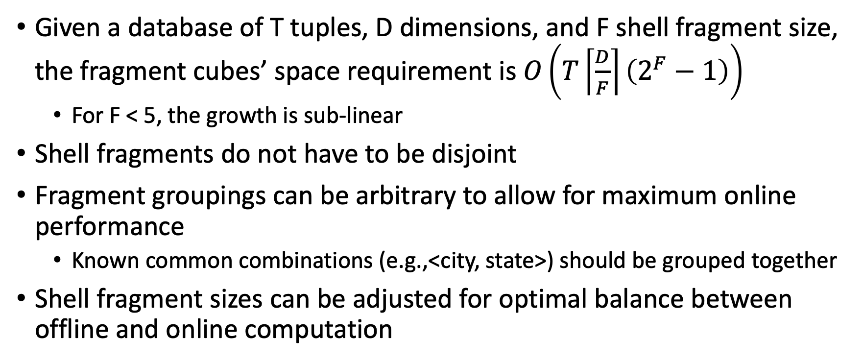
Shell Fragment Cubes: Size and Design
Given a database of T tuples, D dimensions, and F shell fragment size, the fragment cubes’ space requirement is $O\left(T\left\lceil \frac{D}{F}\right\rceil \left(2^{F}−1\right)\right)$
  For F < 5, the growth is sub-linear
Shell fragments do not have to be disjoint
Fragment groupings can be arbitrary to allow for maximum online performance
  Known common combinations (e.g.,<city, state>) should be grouped together
Shell fragment sizes can be adjusted for optimal balance between offline and online computation

Slide 88
Use Frag-Shells for Online OLAP Query Computation
Dimensions
A | B | C | D | E | F | …
A | B | C | D | E | F | G | H | I | J | K | L | M | N | …
ABC Cube
DEF Cube
D Cuboid
EF Cuboid
Instantiated
Base Table
Online
Cube
DE Cuboid
Cell | Tuple-ID List
d1 e1 | {1, 3, 8, 9}
d1 e2 | {2, 4, 6, 7}
d2 e1 | {5, 10}
… | …
Processing query in the form: <a₁, a₂, …, a_{n}: M>

Slide 89
Online Query Computation with Shell-Fragments
A query has the general form: <a1, a2, …, an: M>
Each a_{i} has 3 possible values (e.g., <3, ?, ?, *, 1: count> returns a 2-D data cube)
  Instantiated value
  Aggregate * function
  Inquire ? Function
Method: Given the materialized fragment cubes, process a query as follows
  Divide the query into fragments, same as the shell-fragment
  Fetch the corresponding TID list for each fragment from the fragment cube
  Intersect the TID lists from each fragment to construct instantiated base table
  Compute the data cube using the base table with any cubing algorithm

